Slide 1
CENG-232 Logic Design
Week 6
Synchronous Sequential Logic
Acknowledgement: Most of the following slides are adapted from Prof. Kale's slides at UIUC.

Slide 2
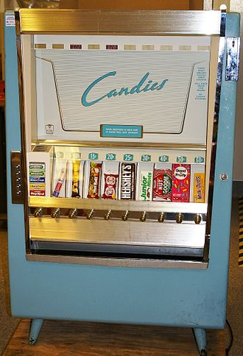
Question: Design a digital circuit to control a vending machine which dispenses a chocolate bar for 75 cents.

Slide 3
A possible solution:
25¢
Dispense
chocolate
If In==1
if Counter==2
Out = 1
Counter = 0
Else
Counter += 1
Out
In
Memory!

Slide 4
Sequential circuits
The second part of CENG232 focuses on sequential circuits, where we add memory to the hardware that we’ve already seen.

Slide 5
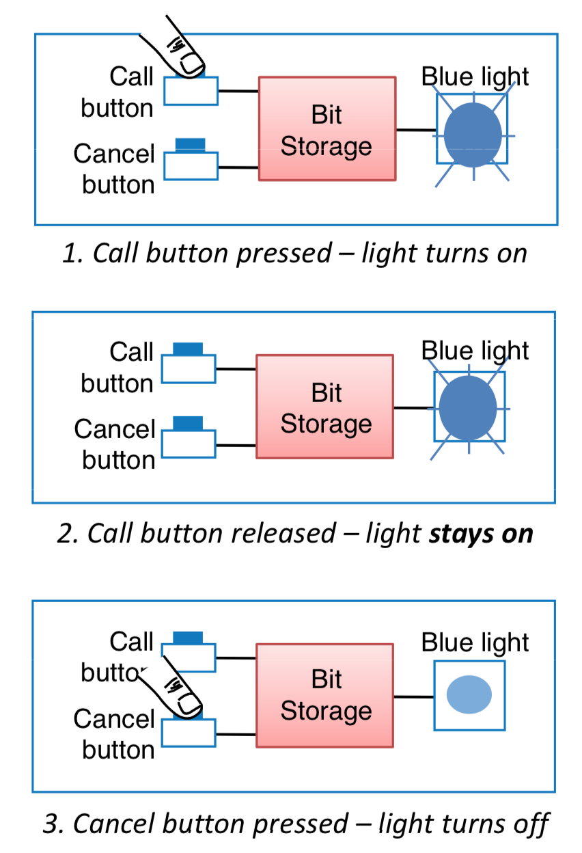
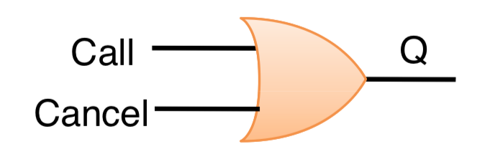
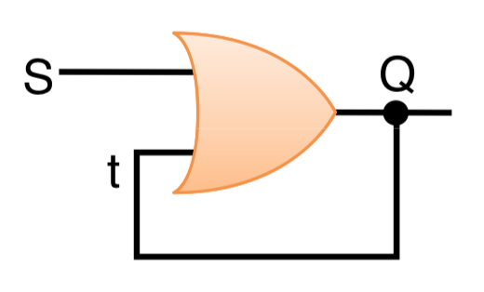
Calling the flight attendant
Trial 1
Trial 2

Slide 6
Combinational vs Sequential
A combinational circuit is specified by its inputs and outputs.
A sequential circuit is specified by a time sequence of inputs, outputs and internal states (or memory).

Slide 7
Combinational Circuits
So far we’ve worked with combinational circuits, where applying the same inputs always produces the same outputs.
This corresponds to a mathematical function where every input has a single, unique output.
Similar to a function (in a programming language) whose computation depends only on the input arguments. (no global variables, no persistent internal states)
Combinational
circuit
Inputs
Outputs

Slide 8
Sequential Circuits
In contrast, the output of a sequential circuit depends on not only the inputs, but also the state, or the current content of a memory block.
Similar to a function (in a programming language) that uses global variables and/or persistent internal states. E.g. list.size()
The memory content changes as the circuit runs.
This makes things more difficult to understand, since the same inputs can yield different outputs, depending on what’s stored in memory
We’ll some need new techniques for analyzing and designing sequential circuits.
Inputs
Combinational
circuit
Outputs
Memory

Slide 9

Examples of Sequential Devices
Many real-life devices are sequential in nature:
Combination locks open if you enter numbers in the right order.
Elevators move up or down and open or close depending on the buttons that are pressed on different floors and in the elevator itself.
Traffic lights switch colors sequentially.
Most importantly, computers are sequential!
For example, key presses and mouse clicks mean different things depending on which program is running and the state of that program.

Slide 10
Types of Sequential Circuits
Synchronous:
Synchronized by a periodic train of clock pulses
The behavior can be defined from the knowledge of its signals at discrete instants of time.
Much easier to design
Asynchronous:
Internal states can change at any instant of time when there is a change in the input variables
No clock signal is required
Have better performance but hard to design due to timing problems
This class mostly covers the synchronous circuits.

Slide 11
Why Asynchronous Circuits?
Used when speed of operation is important
Response quickly without waiting for a clock pulse
Used in small independent systems
Only a few components are required
Used when the input signals may change independently of internal clock
Asynchronous in nature
Used in the communication between two units that have their own independent clocks
Must be done in an asynchronous fashion

Slide 12
Memory
The key ingredient to sequential circuits
A memory should have the following three properties.
It should be able to hold a value.
You should be able to read the value that was saved.
You should be able to change the value that’s saved.
We’ll start with the simplest case, a one-bit memory.
It should be able to hold a single bit, 0 or 1.
You should be able to read the bit that was saved.
You should be able to change the value. Since there’s only a single bit, there are only two choices:
Set the bit to 1
Reset, or clear, the bit to 0.

Slide 13
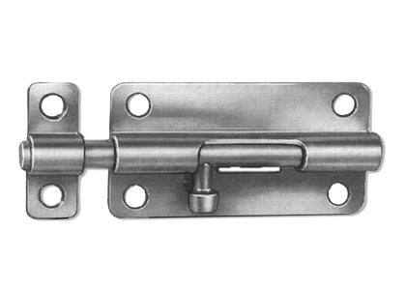

Storage elements
Memory is implemented/realized with storage elements
Two basic types of storage elements
Latches
Flip-flops
Latches operate with input signal levels (rather than clock transitions)
Flip-flops are controlled by clock signal transitions.

Slide 14
Let’s design a 1-bit memory unit (1/2)
We want the following behavior:
X | Y | Z
1 | 0 | 1
0 | 1 | 0
0 | 0 | No change
Expand the last line:
X=0, Y=0, Z_{prev}=0 => Z_{next} = 0
X=0, Y=0, Z_{prev}=1 => Z_{next} = 1
How do you implement this?
-- The basic idea is to have a (feedback) loop, i.e. a circuit output becomes an input

Slide 15
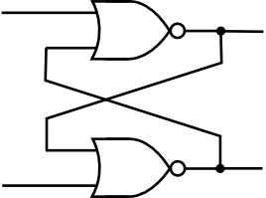
Let’s design a 1-bit memory unit (2/2)
We claim that the following circuit implements the given truth table (previous slide).
Y
Z
What happens when XY=11 ?
Z’
X
Both Z and Z’ become 1. That’s why XY=11 is forbidden!
X | Y |  | Z | Z’
1 | 0 |  | 1 | 0
0 | 1 |  | 0 | 1
0 | 0 | (Z=0,Z’=1) | 0 | 1
0 | 0 | (Z=1,Z’=0) | 1 | 0

Slide 16
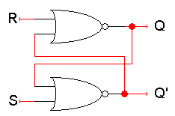
The SR latch
We use the same circuit as before but we change the input/output names.
The “SR latch” here has two inputs S and R, which will let us control the outputs Q and Q’.
Study the NAND case!
Q and Q’ are fed back into the circuit. They’re not only outputs, but also inputs!
To figure out how Q and Q’ change, we have to look at not only the inputs S and R, but also the current values of Q and Q’:
Let’s see how different input values for S and R affect the output ...
Q_{next} = (R + Q’_{current})’
Q’_{next} = (S + Q_{current})’

Slide 17
Setting the Latch: SR = 10
What if S = 1 and R = 0?
Since S = 1, Q’_{next} is 0, regardless of Q_{current}:
Q’_{next} = (1 + Q_{current})’ = 0
Then, this new value of Q’ goes into the top NOR gate, along with R = 0.
Q_{next} = (0 + 0)’ = 1
So when SR = 10, then Q’_{next} = 0 and Q_{next} = 1.
This is how you set the latch to 1 (The S input stands for “Set”; R: “Reset”).
Notice that it can take up to two steps (two gate delays) from the time S becomes 1 to the time Q_{next} becomes 1.
But once Q_{next} becomes 1, the outputs will stop changing. This is a stable state.
Q_{next} = (R + Q’_{current})’
Q’_{next} = (S + Q_{current})’

Slide 18
Latch Delays
Timing diagrams are especially useful in understanding how sequential circuits work.
Here is a timing diagram which shows an example of how our latch outputs change with inputs SR=10.
Suppose that initially, Q = 0 and Q’ = 1.
Since S=1, Q’ will change from 1 to 0 after one NOR-gate delay (marked by vertical lines in the diagram for clarity).
This change in Q’, along with R=0, causes Q to become 1 after another gate delay.
The latch then stabilizes until S or R change again.
Q_{next} = (R + Q’_{current})’
Q’_{next} = (S + Q_{current})’
0 1 2 3 4
S
R
Q
Q’

Slide 19
Resetting the Latch: SR = 01
What if S = 0 and R = 1?
Since R = 1, Q_{next} is 0, regardless of Q_{current}:
Q_{next} = (1 + Q’_{current})’ = 0
Then, this new value of Q goes into the bottom NOR gate, where S = 0.
Q’_{next} = (0 + 0)’ = 1
So when SR = 01, then …
Q_{next} = 0 and Q’_{next} = 1.
This is how you reset or clear the latch to 0. The R input stands for “reset.”
Again, it can take two gate delays before a change in R propagates to the output Q’_{next}.
Q_{next} = (R + Q’_{current})’
Q’_{next} = (S + Q_{current})’

Slide 20
Storing a value: SR = 00
What if S = 0 and R = 0?
The circuit on the right reduces to:
Q_{next} = (0 + Q’_{current})’ = Q_{current}
Q’_{next} = (0 + Q_{current})’ = Q’_{current}
So when SR = 00, then Q_{next} = Q_{current}
Q’_{next} = Q’_{current}
Whatever value Q has, it keeps.
This is exactly what we need to store values in the latch.
“Remain in the same state”
Q_{next} = (R + Q’_{current})’
Q’_{next} = (S + Q_{current})’

Slide 21
SR latches are memories!
This table shows that our latch provides everything we need in a memory: we can set it, reset it, and remember the current value.
The output Q represents the data stored in the latch. It is sometimes called the state of the latch.
We can expand the table above into a state table, which explicitly shows that the next values of Q and Q’ depend on their current values, as well as on the inputs S and R.

Slide 22
SR latches are sequential!
Notice that for inputs SR = 00, the next value of Q could be either 0 or 1, depending on the current value of Q.
So the same inputs can yield different outputs, depending on whether the latch was previously set or reset.
This is very different from the combinational circuits that we’ve seen so far, where the same inputs always yield the same outputs.

Slide 23
What about SR = 11?
Both Q_{next} and Q’_{next} will become 0.
This contradicts the assumption/requirement that Q and Q’ are always complements.
Another problem is what happens if we then make S = 0 and R = 0 together.
Q_{next} = (0 + 0)’ = 1
Q’_{next} = (0 + 0)’ = 1
Q_{next} = (R + Q’_{current})’
Q’_{next} = (S + Q_{current})’
1
0
1
0
0
1
0
1

Slide 24
What about SR = 11?
But these new values go back into the NOR gates, and in the next step we get:
Q_{next} = (0 + 1)’ = 0
Q’_{next} = (0 + 1)’ = 0
The circuit enters an infinite loop, where Q and Q’ cycle between 0 and 1 forever.
So do not set SR=11, this input combination is forbidden.
Q_{next} = (R + Q’_{current})’
Q’_{next} = (S + Q_{current})’
0
0
0
0
0
1
0
1

Slide 25
SR latch summary
Completing the picture
S | R | Q
1 | 0 | 1
0 | 1 | 0
0 | 0 | No change
1 | 1 | Forbidden
SR=10 is called “Set” (sets Q to 1)
SR=01 is called “Reset” (resets or clear Q to 0)

Slide 26
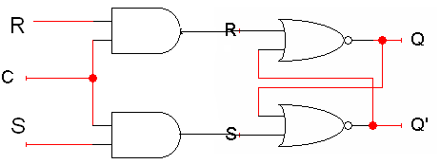
An SR latch with a control input
Here is an SR latch with a control input C.
Notice the hierarchical design!
The dotted box is the SR latch from the previous slide.
The additional AND gates are simply used to generate the correct inputs for the SR latch.
The control input acts just like an enable.

Slide 27
Question
How could we eliminate the undesirable condition of the indeterminate state, i.e. SR=11?
Answer: By making sure that S and R cannot be 1 at the same time.
The “D latch” does this.

Slide 28
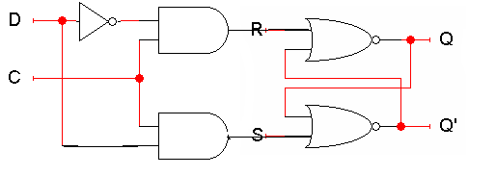
D latch
A D latch is based on an SR latch. The additional gates generate the S and R signals, based on inputs D (“data”) and C (“control”).
When C = 0, S and R are both 0, so the state Q does not change.
When C = 1, the latch output Q will be equal the input D.
No more messing with one input for set and another input for reset!
Also, this latch has no “bad” input combinations to avoid. Any of the four possible assignments to C and D are valid.

Slide 29
Sequential circuits and state diagrams
To describe combinational circuits, we used Boolean expressions and truth tables. With sequential circuits, we can still use expressions and tables, but we can also use another form called a state diagram.
We draw one node for each state that the circuit can be in. Latches have only two states: Q=0 and Q=1.
Arrows between nodes are labeled with “input/output” and indicate how the circuit changes states and what its outputs are. In this case the state and the output are the same.
Here’s a state diagram for a D latch with inputs C and D.
0x/0
0x/1
11/1
10/0
Q=0
Q=1
11/1
10/0

Slide 30
Using latches in real life
We can connect some latches, acting as memory, to an ALU (Arithmetic Logic Unit).
Let’s say these latches contain some value that we want to increment.
The ALU should read the current latch value.
It applies the “G = X + 1” operation.
The incremented value is stored back into the latches.
At this point, we have to stop the cycle, so the latch value doesn’t get incremented again by accident.
One convenient way to break the loop, is to disable the latches.
+1
S
ALU
G
X
D
Q
Latches
C

Slide 31
The problem with latches
The problem is exactly when to disable the latches. You have to wait long enough for the ALU to produce its output, but no longer.
Different ALU operations have different delays. For instance, arithmetic operations might go through an adder, whereas logical operations don’t.
Changing the ALU implementation, such as using a carry-lookahead adder instead of a ripple-carry adder, also affects the delay.
In general, it’s very difficult to know how long operations take, and how long latches should be enabled for.
+1
S
ALU
G
X
D
Q
Latches
C

Slide 32
Flip-Flops (FFs)
We’ll address some of the shortcomings of latches by using them to build flip-flops.
Adding a “clock” signal helps circuits synchronize their actions.
We’ll also need to disable memory units quickly.

Slide 33
Making latches work right
Our example used latches as memory for an ALU.
Let’s say there are four latches initially storing 0000.
We want to use an ALU to increment that value to 0001.
Normally the latches should be disabled, to prevent unwanted data from being accidentally stored.
In our example, the ALU can read the current latch contents, 0000, and compute their increment, 0001.
But the new value cannot be stored back while the latch is disabled.
+1
S
ALU
G
X
0001
0000
D
Q
Latches
C
0

Slide 34
Writing to the latches
After the ALU has finished its increment operation, the latch can be enabled, and the updated value is stored.
The latch must be quickly disabled again, before the ALU has a chance to read the new value 0001 and produce a new result 0010.
+1
S
ALU
G
X
0001
0001
D
Q
Latches
C
1
+1
S
ALU
G
X
0010
0001
D
Q
Latches
C
0

Slide 35
Two main issues
So to use latches correctly within a circuit, we have to:
Keep the latches disabled until new values are ready to be stored.
Enable the latches just long enough for the update to occur.
There are two main issues we need to address:
 How do we know exactly when the new values are ready?
We’ll add another signal to our circuit. When this new
signal becomes 1, the latches will know that the ALU
computation has completed and data is ready to be stored.
 How can we enable and then quickly disable the latches?
This can be done by combining latches together in a
special way, to form what are called flip-flops.

Slide 36
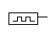
Clocks and synchronization
A clock is a special device that whose output continuously alternates between 0 and 1.
The time it takes the clock to change from 1 to 0 and back to 1 is called the clock period, or clock cycle time (T).
The clock frequency (f) is the inverse of the clock period (T = 1/f). The unit of measurement for frequency is the hertz.
Clocks are often used to synchronize circuits.
They generate a repeating, predictable pattern of 0s and 1s that can trigger certain events in a circuit, such as writing to a latch.
If several circuits share a common clock signal, they can coordinate their actions with respect to one another.
This is similar to how humans use real clocks for synchronization.
clock period

Slide 37
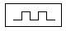
Synchronizing our example
We can use a clock to synchronize our latches with the ALU.
The clock signal is connected to the latch control input C.
The clock controls the latches. When it becomes 1, the latches will be enabled for writing.
The clock period must be set appropriately for the ALU.
It should not be too short. Otherwise, the latches will start writing before the ALU operation has finished.
It should not be too long either. Otherwise, the ALU might produce a new result that will accidentally get stored, as we saw before.
The faster the ALU runs, the shorter the clock period can be.
+1
S
ALU
G
X
D
Q
Latches
C

Slide 38
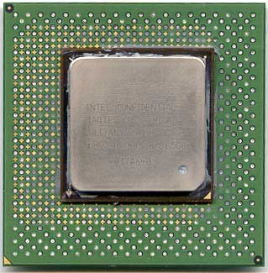
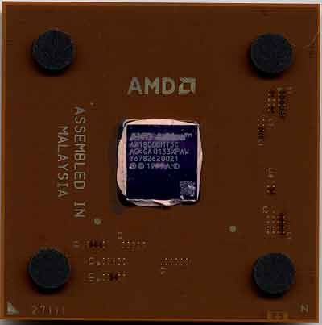
More about clocks
Clocks are used extensively in computer architecture.
All processors run with an internal clock.
Modern chips can run at frequencies around 2.8 GHz.
This works out to a cycle time as little as 0.36 ns!
Memory modules are often rated by their clock speeds too. Examples include “PC133” and “PC800” memory.
Be careful... higher frequencies do not always mean faster machines!
You also have to consider how much work is actually being done during each clock cycle.
How much stuff can really get done in just 0.36 ns?
More in CENG331.

Slide 40
SR latch
Completing the picture
S | R | Q
1 | 0 | 1
0 | 1 | 0
0 | 0 | No change
1 | 1 | Forbidden
SR=10 is called “Set” (sets Q to 1)
SR=01 is called “Reset” (resets or clear Q to 0)

Slide 41
D latch
A D latch is based on an SR latch. The additional gates generate the S and R signals, based on inputs D (“data”) and C (“control”).
When C = 0, S and R are both 0, so the state Q does not change.
When C = 1, the latch output Q will be equal the input D.
No more messing with one input for set and another input for reset!
Also, this latch has no “bad” input combinations to avoid. Any of the four possible assignments to C and D are valid.

Slide 42
Writing to the latches
After the ALU has finished its increment operation, the latch can be enabled, and the updated value is stored.
The latch must be quickly disabled again, before the ALU has a chance to read the new value 0001 and produce a new result 0010.
+1
S
ALU
G
X
0001
0001
D
Q
Latches
C
1
+1
S
ALU
G
X
0010
0001
D
Q
Latches
C
0

Slide 43
Two main issues
Keep the latches disabled until new values are ready to be stored.
How do we know exactly when the new values are ready?
By synchronizing their operations
Enable the latches just long enough for the update to occur.
How can we enable and then quickly disable the latches?
By combining latches together in a special way, to form flip-flops.
clock period

Slide 44
Synchronizing our example
We can use a clock to synchronize our latches with the ALU.
The clock signal is connected to the latch control input C.
The clock controls the latches. When it becomes 1, the latches will be enabled for writing.
The clock period must be set appropriately for the ALU.
It should not be too short. Otherwise, the latches will start writing before the ALU operation has finished.
It should not be too long either. Otherwise, the ALU might produce a new result that will accidentally get stored, as we saw before.
The faster the ALU runs, the shorter the clock period can be.
+1
S
ALU
G
X
D
Q
Latches
C

Slide 45
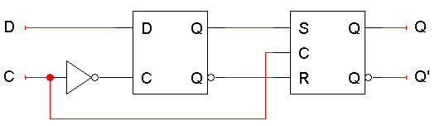
Flip-Flops
The second issue was how to enable a latch for just an instant (If you keep it enabled longer than needed, than a new value might get written.)
Here is the internal structure of a D flip-flop.
The flip-flop inputs are C and D; and the outputs are Q and Q’.
The D latch on the left is the master, while the SR latch on the right is called the slave.
Note the layout here.
The flip-flop input D is connected directly to the master latch.
The master latch output goes to the slave.
The flip-flop outputs come directly from the slave latch.

Slide 46
D flip-flops when C=0
The D flip-flop’s control input C enables either the D latch or the SR latch, but not both.
When C = 0:
The master latch is enabled, and it monitors the flip-flop input D. Whenever D changes, the master’s output changes too.
The slave is disabled, so the D latch output has no effect on it. Thus, the slave just maintains the flip-flop’s current state.

Slide 47
D flip-flops when C=1
As soon as C becomes 1,
The master is disabled. Its output will be the last D input value seen just before C became 1.
Any subsequent changes to the D input while C = 1 have no effect on the master latch, which is now disabled.
The slave latch is enabled. Its state changes to reflect the master’s output, which again is the D input value from right when C became 1.

Slide 48
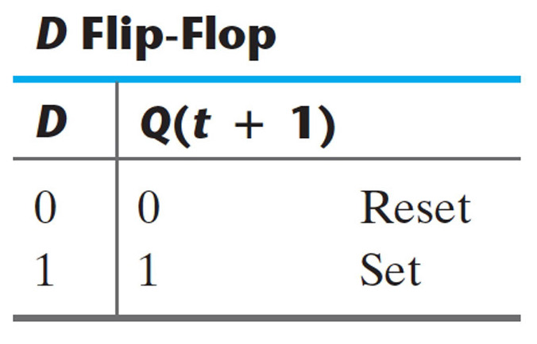
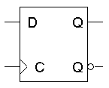
Positive edge triggering
This is called a positive edge-triggered flip-flop.
The flip-flop output Q changes only after the positive edge of C.
The change is based on the flip-flop input values that were present right at the positive edge of the clock signal.
The D flip-flop’s behavior is similar to that of a D latch except for the positive edge-triggered nature, which is not explicit in this table.
D latch

Slide 49
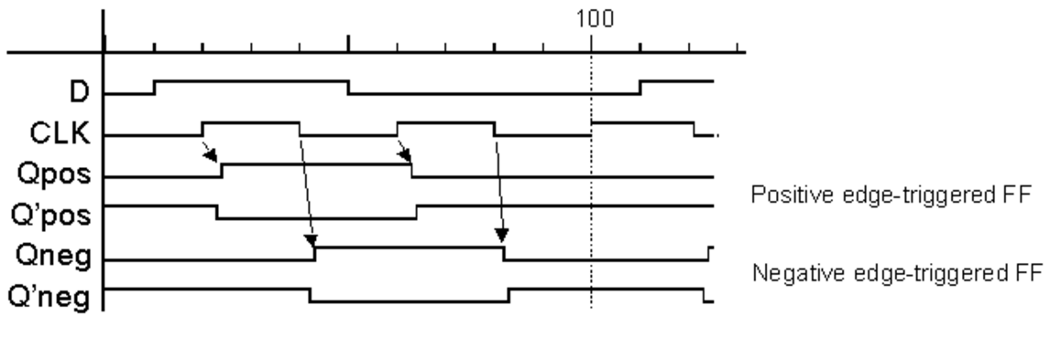
Timing diagram

Slide 50
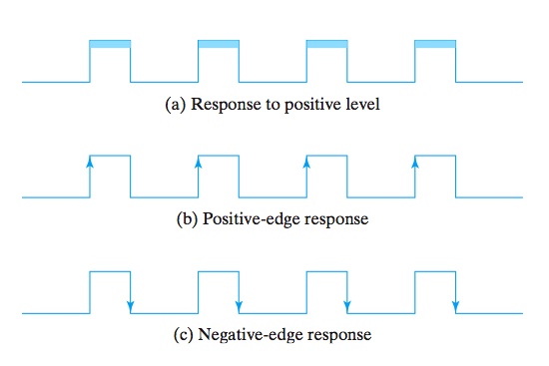
Responding to a Clock
Clock response in latch (a) and flip-flops (b-c).

Slide 51
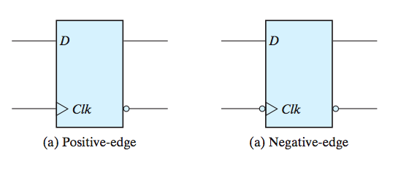
FF Symbols

Slide 52
Direct inputs
One last thing to worry about …
What is the starting value of Q?
We could set the initial value synchronously, at the next positive clock edge, but this actually makes circuit design more difficult.
Instead, most flip-flops provide direct (or asynchronous) inputs that let you immediately set or clear the state.
You would “reset” the circuit once, to initialize the flip-flops.
The circuit would then begin its regular, synchronous operation.

Slide 53
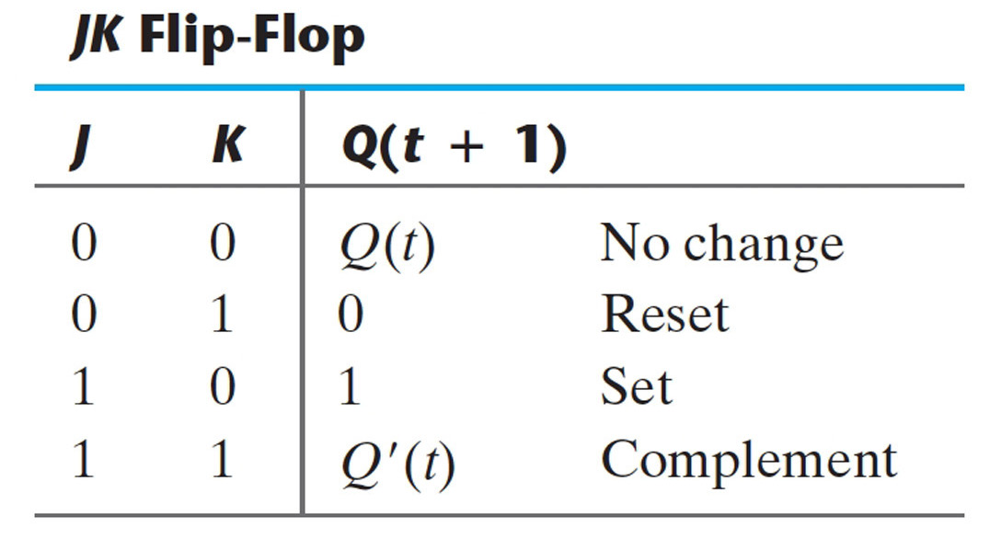
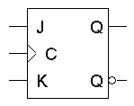
Flip-flop variations (JK)
We can make different versions of flip-flops based on the D flip-flop, just like we made different latches based on the SR latch.
A JK flip-flop has inputs that act like S and R, but the inputs JK=11 are used to complement the flip-flop’s current state.

Slide 54
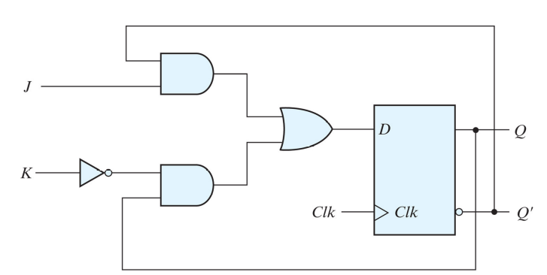
Figure 5.12 in the textbook

Slide 55
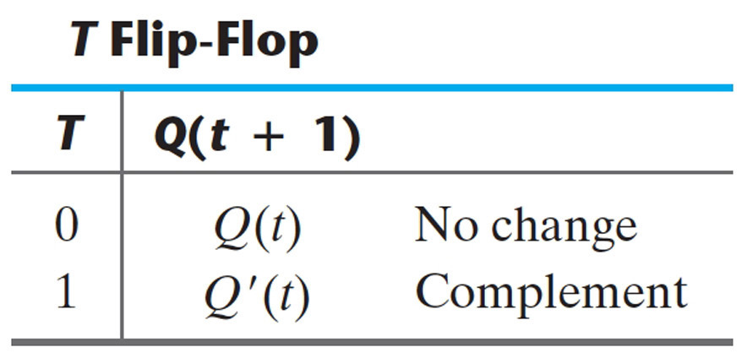
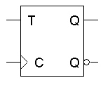
Flip-flop variations (T)
A T flip-flop can only maintain or complement its current state.

Slide 56
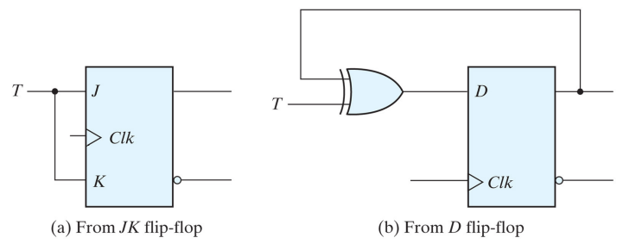
Q: Implement a T FF using a D FF

Slide 57
Characteristic Tables
The tables that we’ve seen so far are called characteristic tables.
They show the next state Q(t+1) in terms of the current state Q(t) and the inputs.
For simplicity, the control input C is not usually listed.
Again, these tables don’t indicate the positive edge-triggered behavior of the flip-flops that we’ll be using.

Slide 58
Characteristic Equations
We can also write characteristic equations, where the next state Q(t+1) is defined in terms of the current state Q(t) and inputs.
Q(t+1) = D
Q(t+1) = K’.Q(t) + J.Q’(t)
Q(t+1) = T’.Q(t) + T.Q’(t)
= T ⊕ Q(t)

Slide 59
Flip flop timing diagrams
“Present state” and “next state” are relative terms.
In the example JK flip-flop timing diagram on the left, you can see that at the first positive clock edge, J=1, K=1 and Q(1) = 1.
We can use this information to find the “next” state,
Q(2) = Q(1)’.
Q(2) appears right after the first positive clock edge, as shown on the right. It will not change again until after the second clock edge.
1 2 3 4
1 2 3 4
C
J
K
Q
C
J
K
Q
These values at clock cycle 1...
… determine the “next” Q

Slide 60
“Present” and “Next” are relative
Similarly, the values of J, K and Q at the second positive clock edge can be used to find the value of Q during the third clock cycle.
When we do this, Q(2) is now referred to as the “present” state, and Q(3) is now the “next” state.
1 2 3 4
1 2 3 4
C
J
K
Q
C
J
K
Q

Slide 61
Positive edge triggered
One final point to repeat: the flip-flop outputs are affected only by the input values at the positive edge.
In the diagram below, K changes rapidly between the second (2) and third (3) positive edges.
But it’s only the input values at the third clock edge (K=1, and J=0 and Q=1) that affect the next state, so here Q changes to 0.
This is a fairly simple timing model. In real life there are “setup times” and “hold times” to worry about as well, to account for internal and external delays.
1 2 3 4
C
J
K
Q

Slide 62
Summary
To use memory in a larger circuit, we need to:
Keep the latches disabled until new values are ready to be stored.
Enable the latches just long enough for the update to occur.
A clock signal is used to synchronize circuits. The cycle time reflects how long combinational operations take.
Flip-flops further restrict the memory writing interval, to discrete instant of time (e.g. the positive edge of the clock signal).
This ensures that memory is updated only once per clock cycle.
There are several different kinds of flip-flops, but they all serve the same basic purpose of storing bits.
Next, we’ll talk about how to analyze and design sequential circuits that use flip-flops as memory.

Slide 63
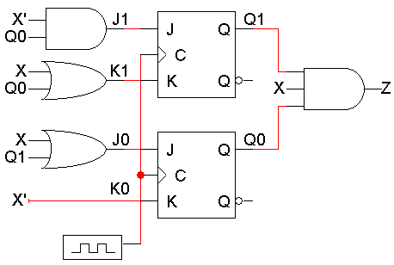
An example sequential circuit
Here is a sequential circuit with two JK flip-flops. There is one input, X, and one output, Z.
The values of the flip-flops (Q1Q0) form the state, or the memory, of the circuit.
The flip-flop outputs also go back into the primitive gates on the left. This fits the general sequential circuit diagram at the bottom.
X
Z
Inputs
Combinational
circuit
Outputs
Q0
Q1
Memory

Slide 64
Analyzing a sequential circuit
For a combinational circuit → we have a truth table
For a sequential circuit → we have a state table
It shows inputs and current states on the left, and outputs and next states on the right.
For a sequential circuit, the outputs depend on the inputs and the current state of the flip-flops.
In addition to outputs, we also need to find the next state of the flip-flops on the next clock cycle.

Slide 65
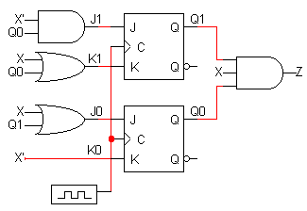
Analyzing our example circuit
A basic state table for our example circuit is shown below.
Remember that there is one input X, one output Z, and two flip-flops Q1Q0.
The present state Q1Q0 and the input will determine the next state and the output.

Slide 66
The outputs are easy
The output depends on the current state (Q₀ and Q₁) as well as the inputs.
From the diagram, you can see that
Z = Q₁Q₀X
(Output at the current time)

Slide 67
Flip-flop Input Equations
Finding the next states is harder.
To do this, we have to figure out how the flip-flops are changing.
Step 1:
Find Boolean expressions for the flip-flop inputs.
i.e., How do the inputs (say, J & K) to the flip-flops
depend on the current state and input
Step 2:
Use these expressions to find the actual flip-flop input values for each possible combination of present states and inputs.
i.e., Fill in the state table (with new intermediate columns)
Step 3:
Use flip-flop characteristic tables or equations to find the next states, based on the flip-flop input values and the present states.

Slide 68
Step 1: Flip-flop input equations
For our example, the flip-flop input equations are:
J1 = X’ Q0
K1 = X + Q0
J0 = X + Q1
K0 = X’
JK flip-flops each have two inputs, J and K. (D and T flip-flops have one input each.)

Slide 69
Step 2: Flip-flop input values
With these equations, we can make a table showing J1, K1, J0 and K0 for the different combinations of present state Q1Q0 and input X.
J1 = X’ Q0 J0 = X + Q1
K1 = X + Q0 K0 = X’

Slide 70
Step 3: Find the next states
Finally, use the JK flip-flop characteristic tables or equations to find the next state of each flip-flop, based on its present state and inputs.
The general JK flip-flop characteristic equation is:
Q(t+1) = K’Q(t) + JQ’(t)
In our example circuit, we have two JK flip-flops, so we have to apply this equation to each of them:
Q1(t+1) = K1’Q1(t) + J1Q1’(t)
Q0(t+1) = K0’Q0(t) + J0Q0’(t)
We can also determine the next state for
each input/current state combination
directly from the characteristic table.

Slide 71
Step 3 Concluded
Finally, here are the next states for Q1 and Q0, using these equations or the characteristic table:
Q1(t+1) = K1’Q1(t) + J1Q1’(t)
Q0(t+1) = K0’Q0(t) + J0Q0’(t)

Slide 72
Getting state table columns straight
The table starts with Present State and Inputs.
Present State and Inputs yield FF Inputs.
Present State and FF Inputs yield Next State, based on the flip-flop characteristic tables.
Present State and Inputs yield Output.
We really only care about FF Inputs in order to find Next State.

Slide 73
State Diagrams
We can also represent the state table graphically with a state diagram.
The state table of our example and its corresponding state diagram:
input
output
0/0
1/0
1/0
00
01
1/1
0/0
1/0
0/0
0/0
11
10
state

Slide 74
Sizes of State Diagrams
Always check the size of your state diagrams.
If there are n flip-flops, there should be ?? nodes in the diagram.
2^n
If there are m inputs, then each node (i.e. state) will have ?? outgoing arrows.
2^m
In our example, we have two flip-flops, and thus four states or nodes.
There is one input, so each node has two outgoing arrows.
0/0
1/0
1/0
00
01
1/1
0/0
1/0
0/0
0/0
11
10

Slide 75
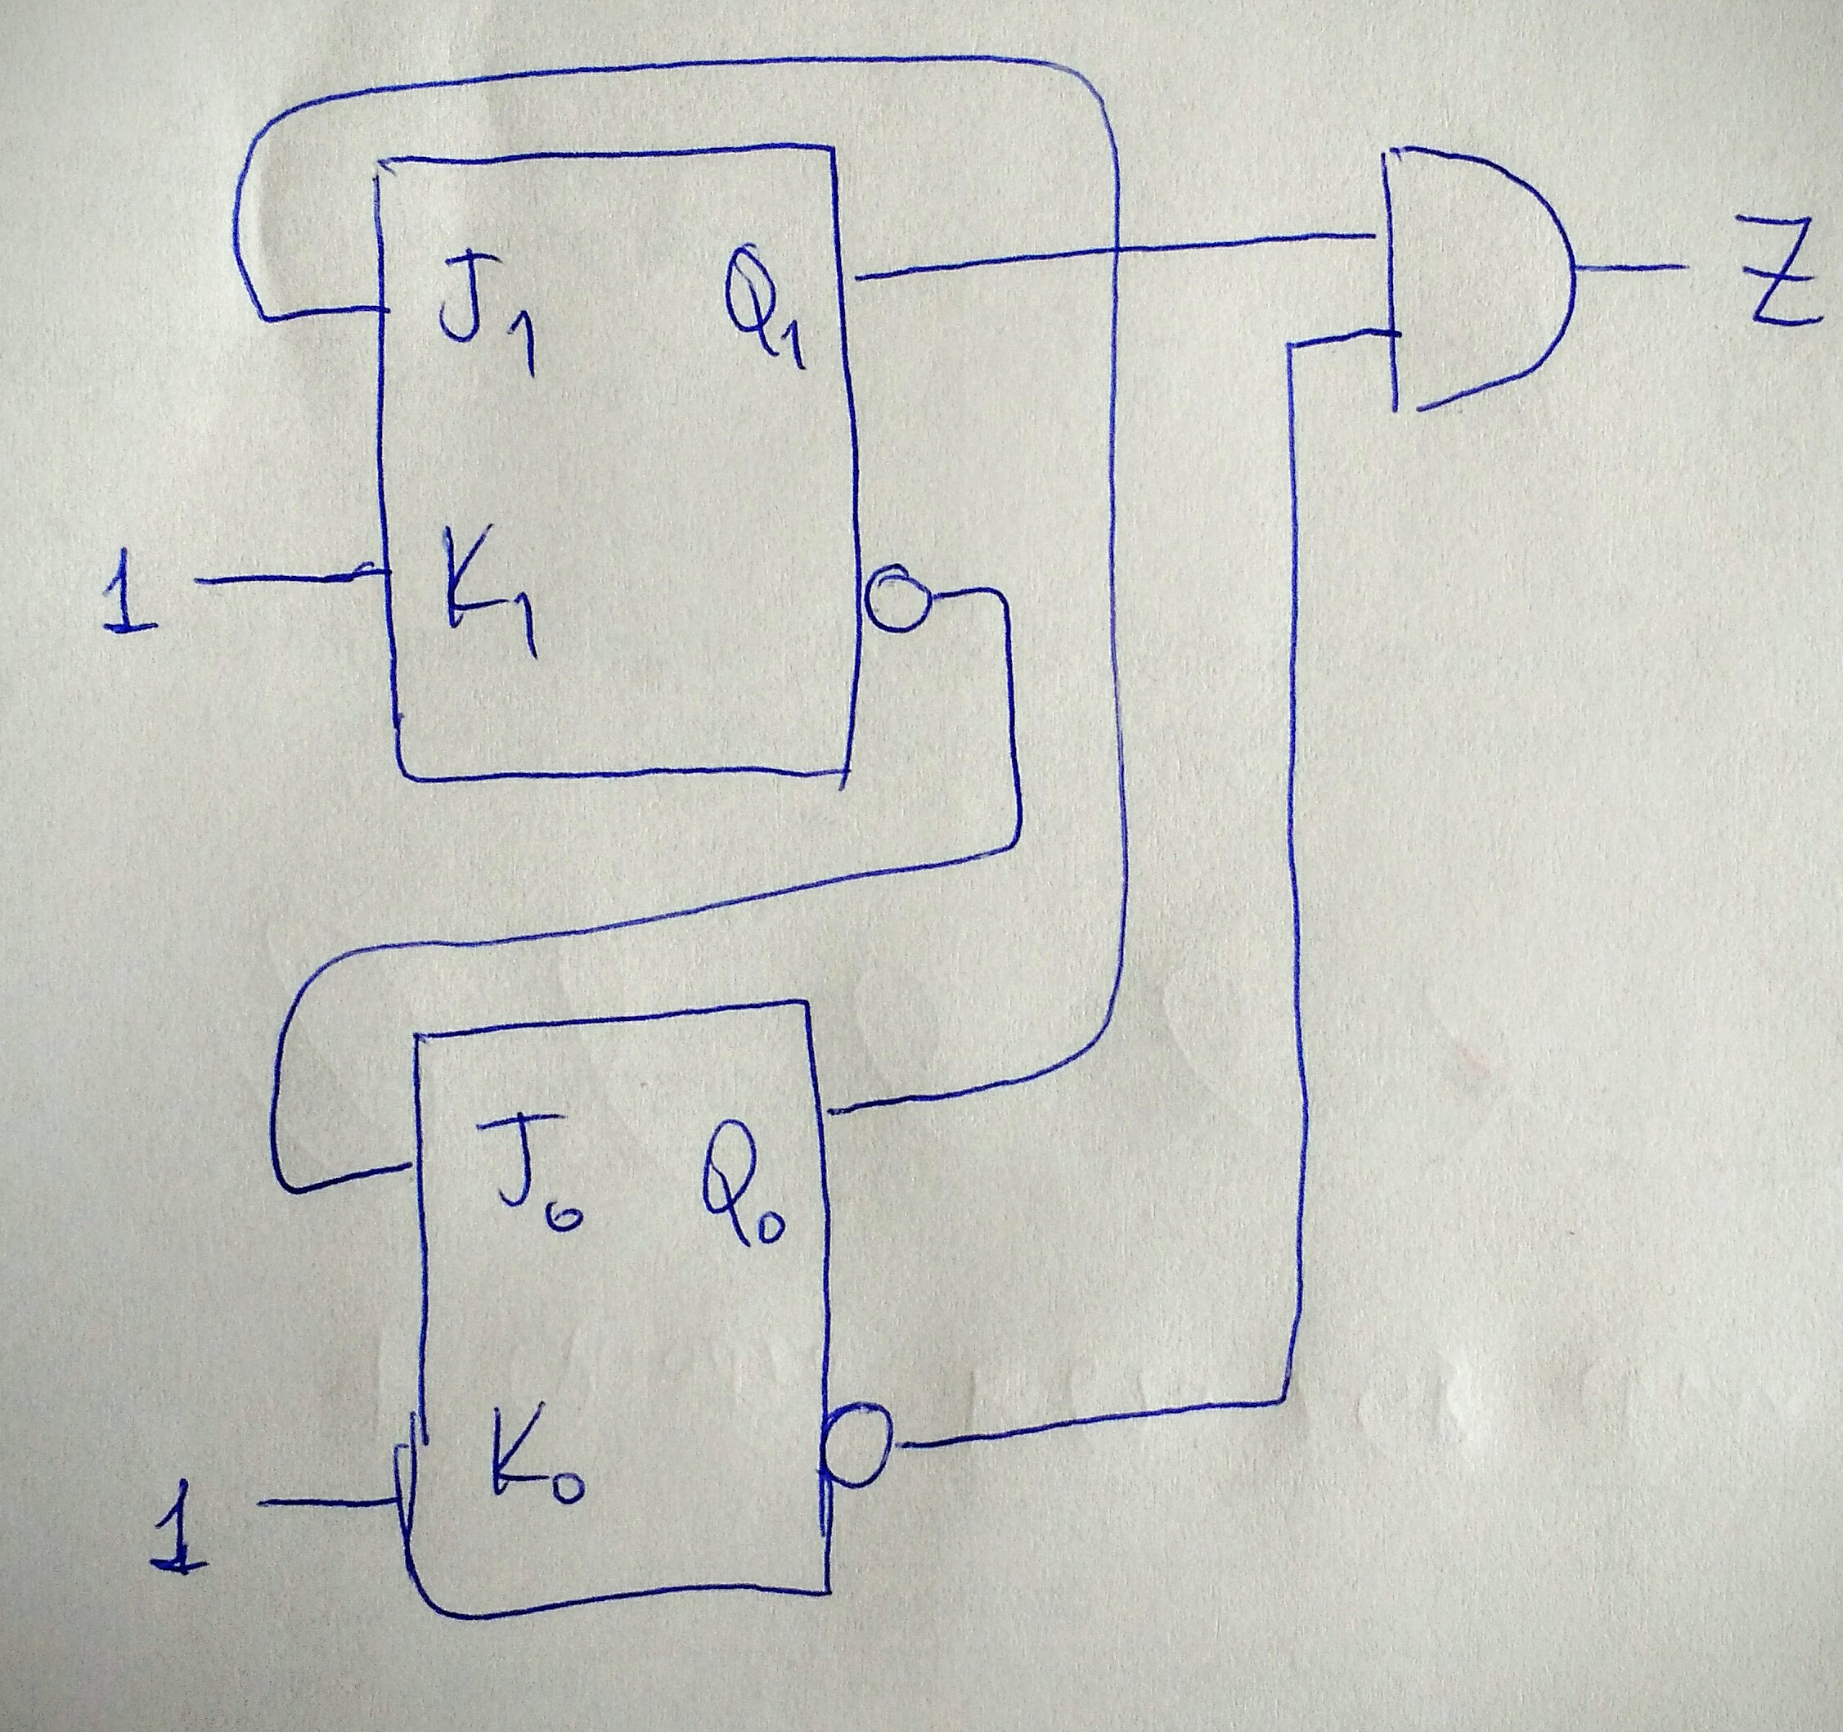
Another analysis example
Modulo-3 counter

Slide 76
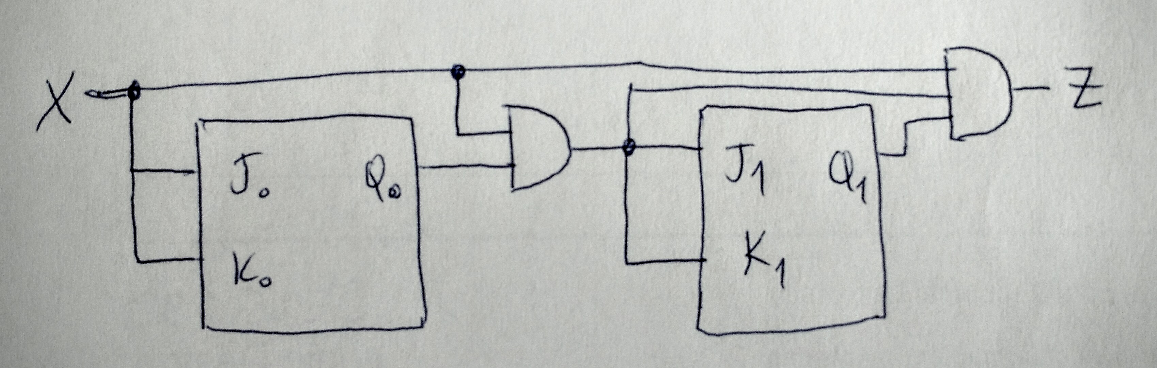
Another analysis example
Modulo-4 counter with enable
Also, study the examples in your book (Figures 5.17,5.18,5.20)

Slide 77
Sequential circuit analysis summary
To analyze sequential circuits, you have to:
Find Boolean expressions for the outputs of the circuit and the flip-flop inputs.
Use these expressions to fill in the output and flip-flop input columns in the state table.
Finally, use the characteristic equation or characteristic table of the flip-flop to fill in the next state columns.
The result of sequential circuit analysis is a state table or a state diagram describing the circuit.

Slide 78
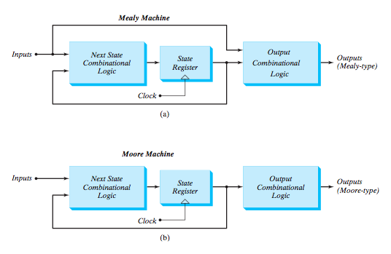
Two models of sequential circuits
These two models are commonly referred to as Finite State Machines (FSM)

